Slide 1
Piggy Bank
by Team 0

Slide 2
What is Piggy Bank?
A web based implementation of a budgeting app
On this app you can…
Log your spending habits
View your expenses
Get suggestions on how to spend and budget
Notes:
(about 1 min) App Intro: briefly introduce the app developed

Slide 3
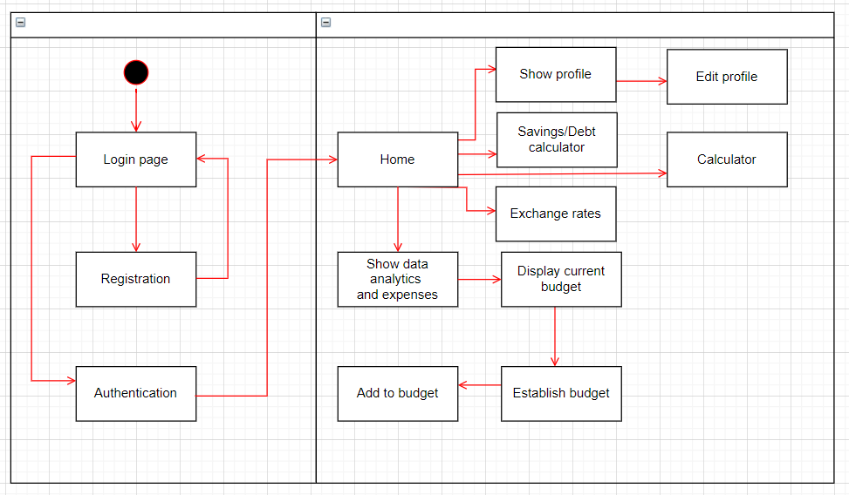
Major Design
Notes:
(about 2 mins) Major Design: briefly describe the design and the techniques used and why you chose them

Slide 4
Major Design
Firebase
React
MVC pattern
Material UI
Observer pattern
Scrum
Paired programming
Code reviewing through GitHub
Notes:
(about 2 mins) Major Design: briefly describe the design and the techniques used and why you chose them

Slide 5
Lessons Learned
Communication is key
Trust your teammates
Time management
Constantly keep scrum sheet up to date
Don’t take on too many tasks
Finish fundamental tasks first, like the database
Notes:
(about 1 mins) Lessons Learned: Briefly summarize any lessons you and your teammates learned in this project, or things you would have done differently

Slide 6
Demo
Notes:
(about 5 mins) Quick Demo:
quickly demonstrate the major attractive functionalities (NO need to show all user stories)
if possible, live demo would be expected! Otherwise, clearly explain why live demo cannot be achieved, then present recorded demo or screenshots.
Rehearsal, rehearsal, rehearsal. Demo takes time, please be concise!

Slide 7
Questions?

